Slide 1
L6 Group 4 – Pitch 6
Oliver Chamberlain
Daniel Jamieson
Ross Warren
Douglas Simpson

Slide 2
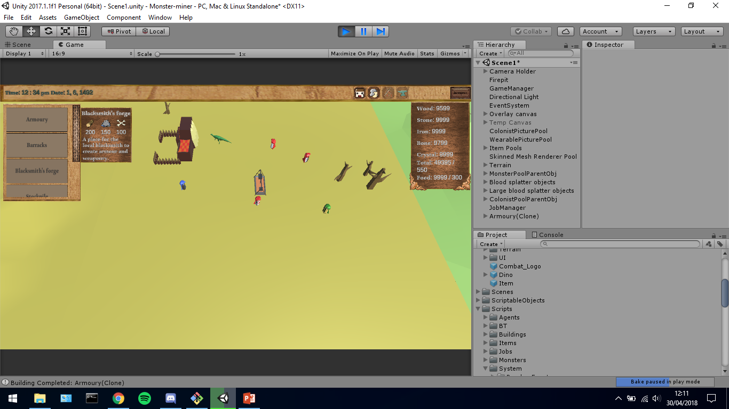
The brief
Game of emergence
Multiple Solutions
Single player
PC
IMAGE OF GAME
DJ

Slide 3
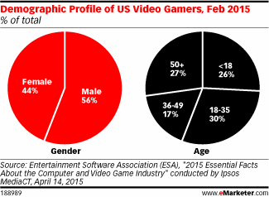
Demographic/Psychographic
Males
Aged 15-25
Students
Management/ City simulation game
RW

Slide 4
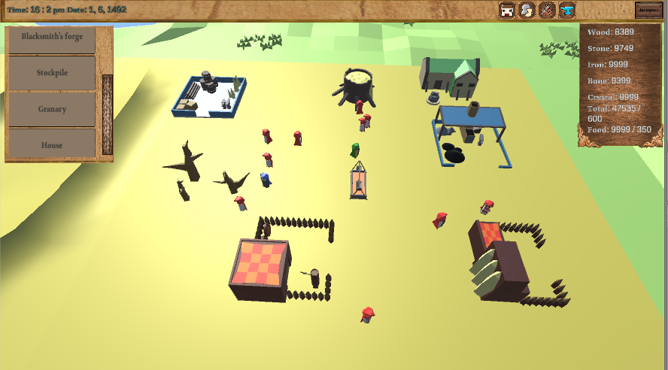
Monster Miner
Colony Simulation
Resource Management
Overhead Camera
Survive and Expand
OC

Slide 5
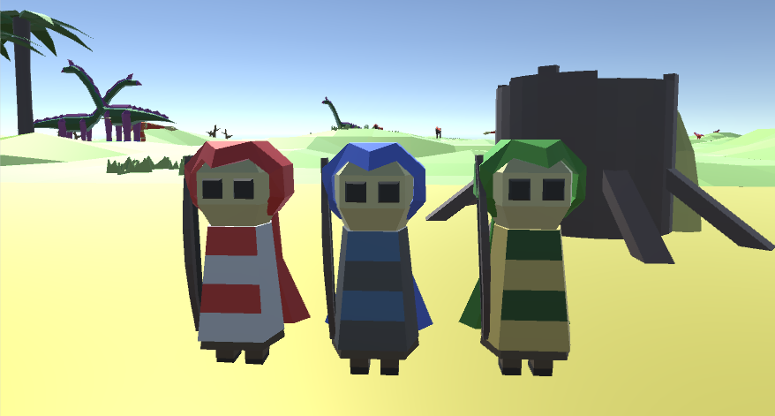
Colonists
Hunter
Crafter
Gatherer
INSERT IMAGE OF COLONISTS
DJ

Slide 6
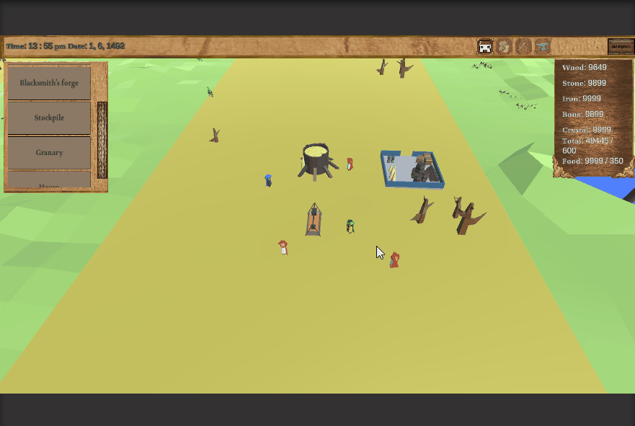
Main loop
Hunt / Gather
Build
Craft
GIF OF MAIN GAME LOOP
OC

Slide 7
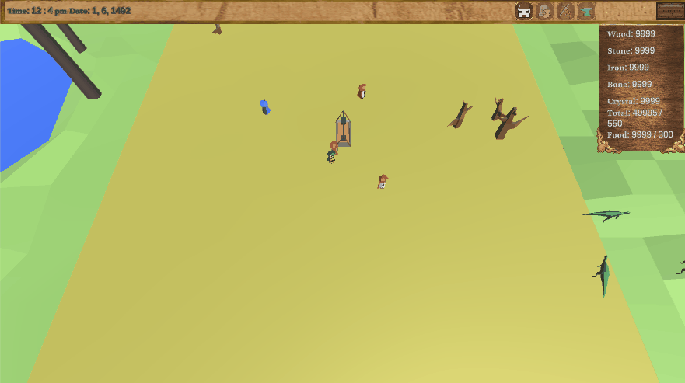
Buildings
Barracks
Blacksmith
Stockpile/Granary
Armoury
House
GIF OF BUILDING PLACEMENT AND USE
OC

Slide 8
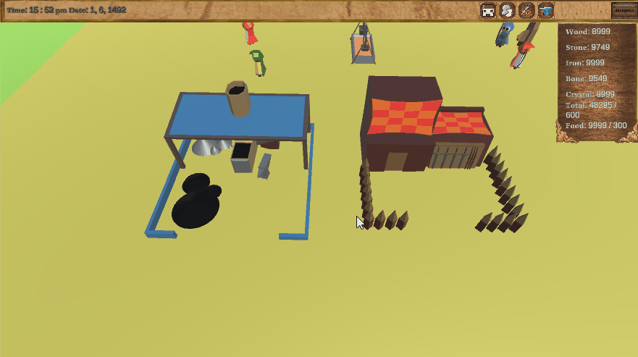
Crafting loop
Gather
Craft
Equip
GIF OF CRAFTING LOOP
OC

Slide 9

Playtesting Feedback
Unclear buttons
Initial monster balancing
Barracks functionality
Lack of challenge
DS

Slide 10
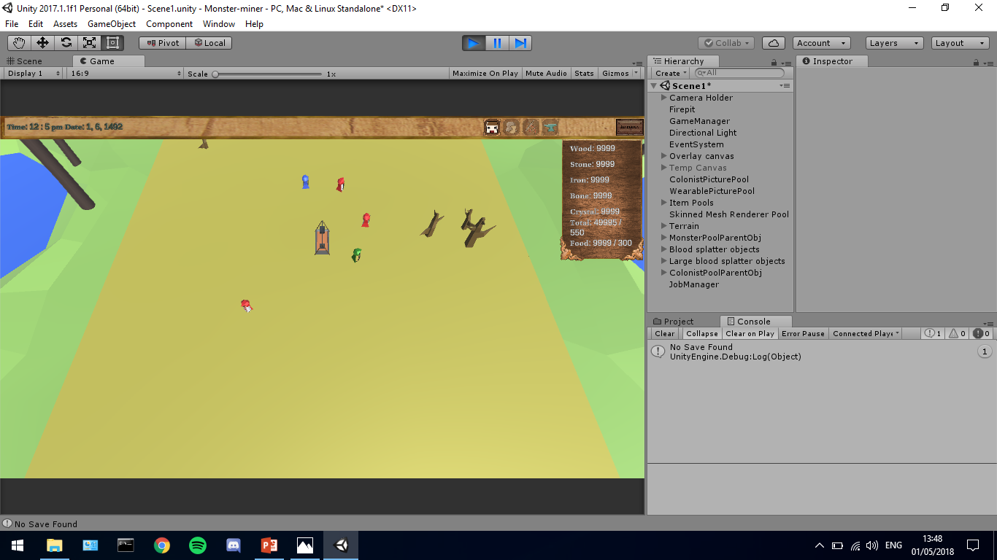
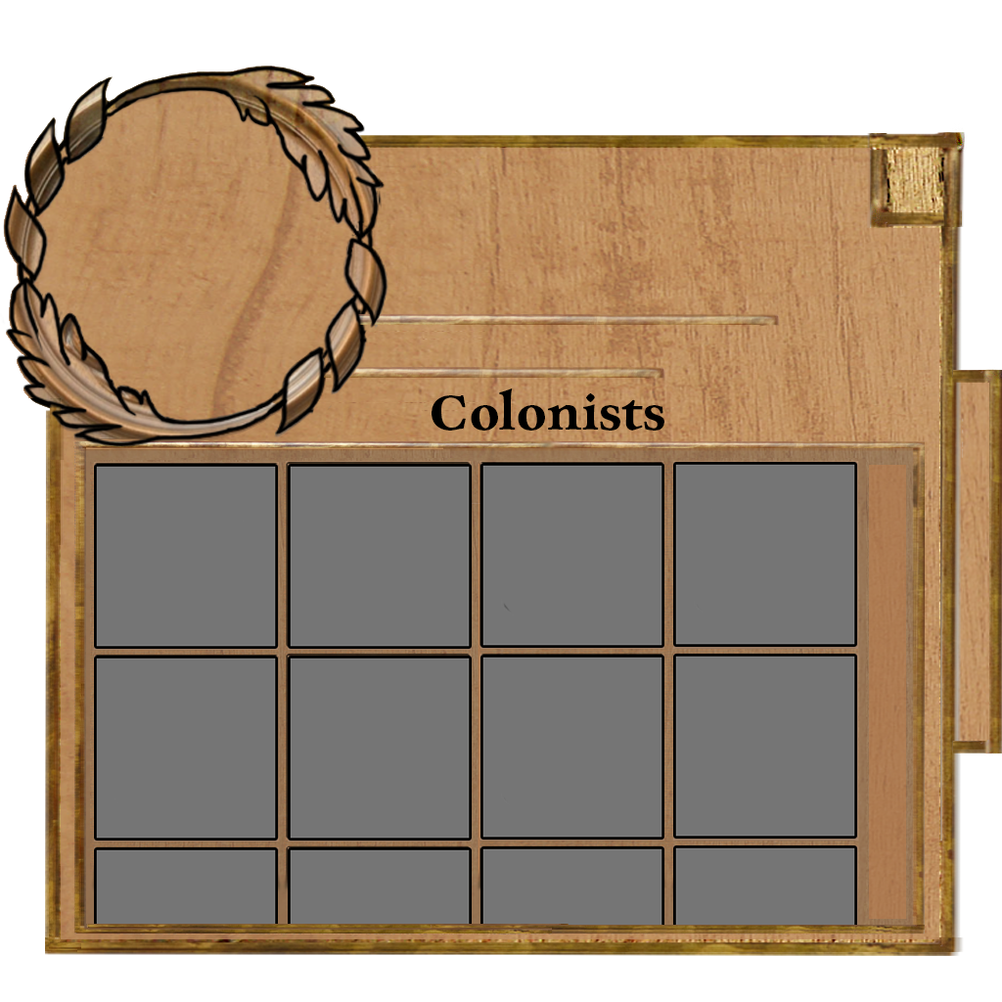
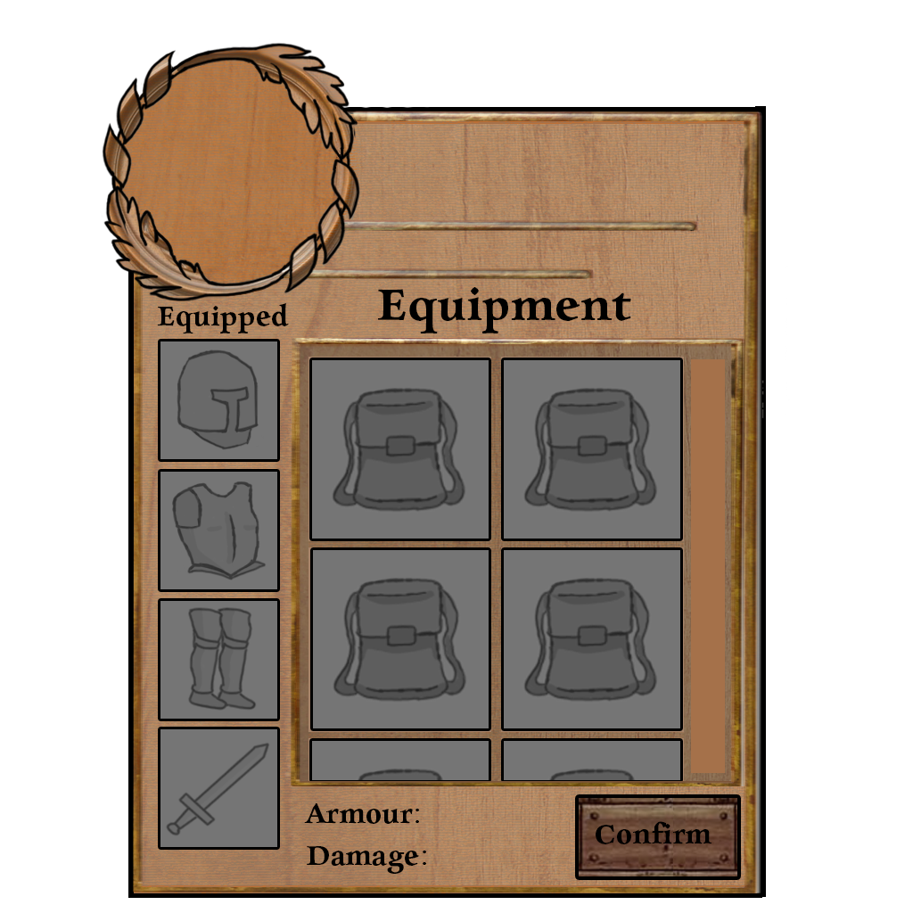
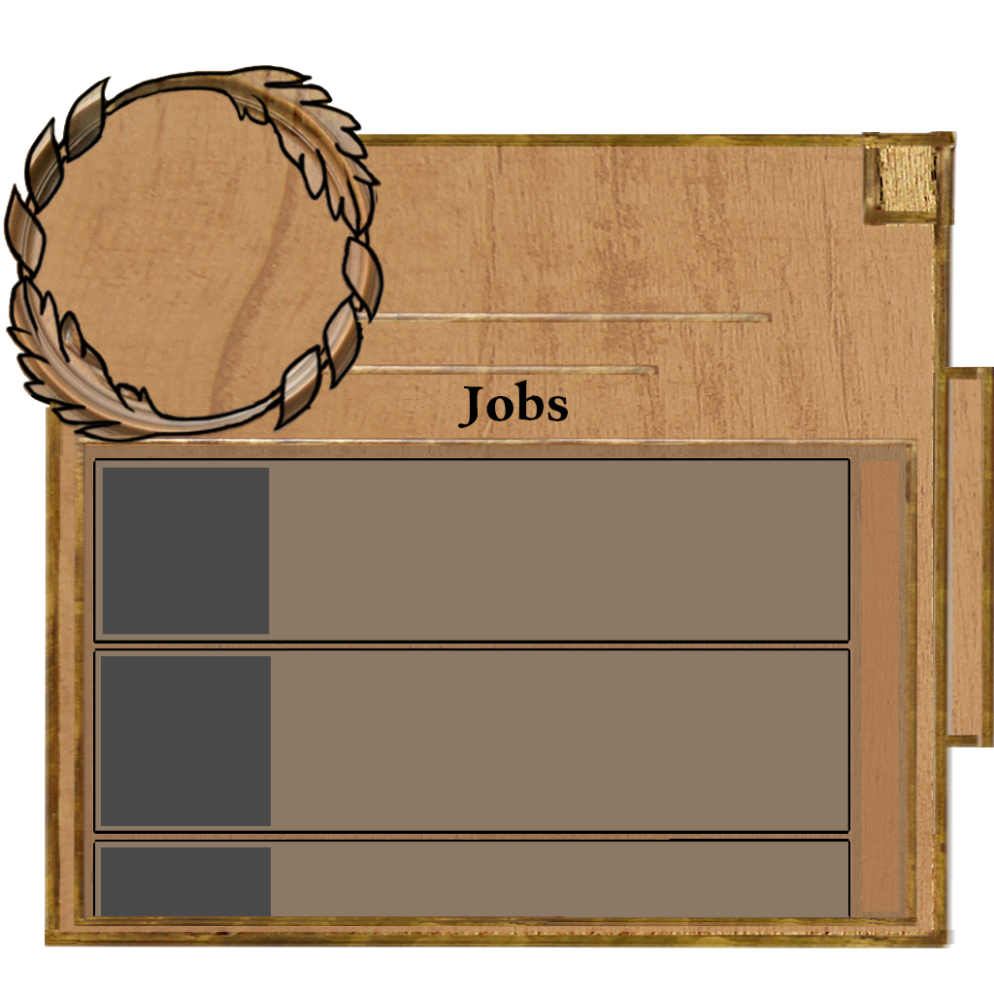
Art Assets (User Interface)
RW

Slide 11
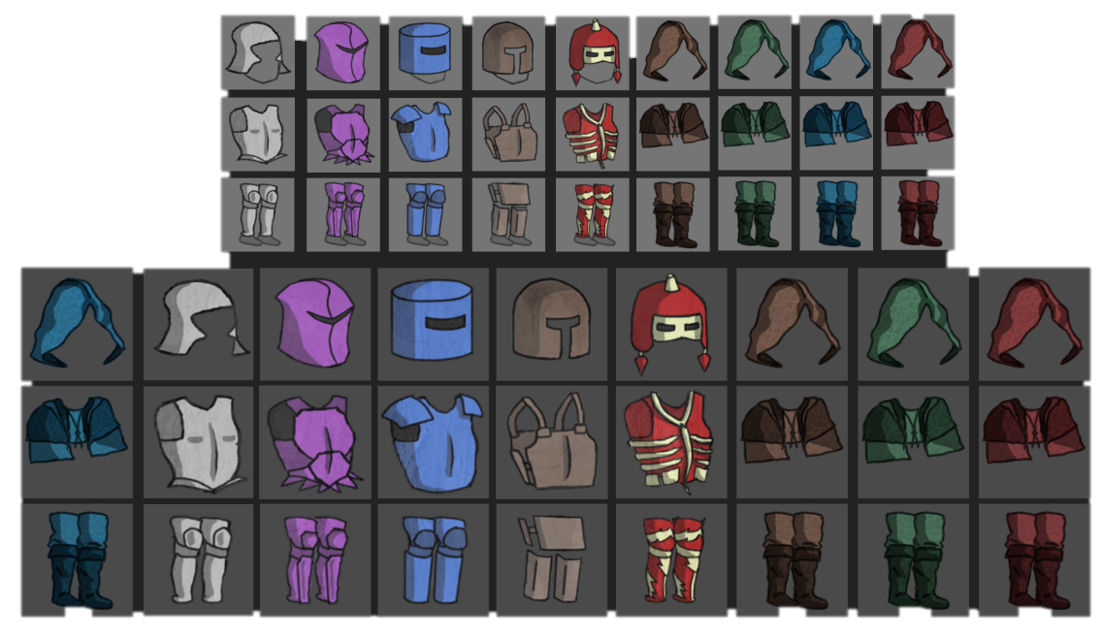
Art Assets (Armour)

Slide 12
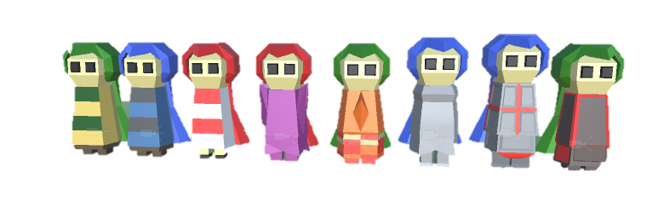
Art Assets (Colonists)
DS

Slide 13

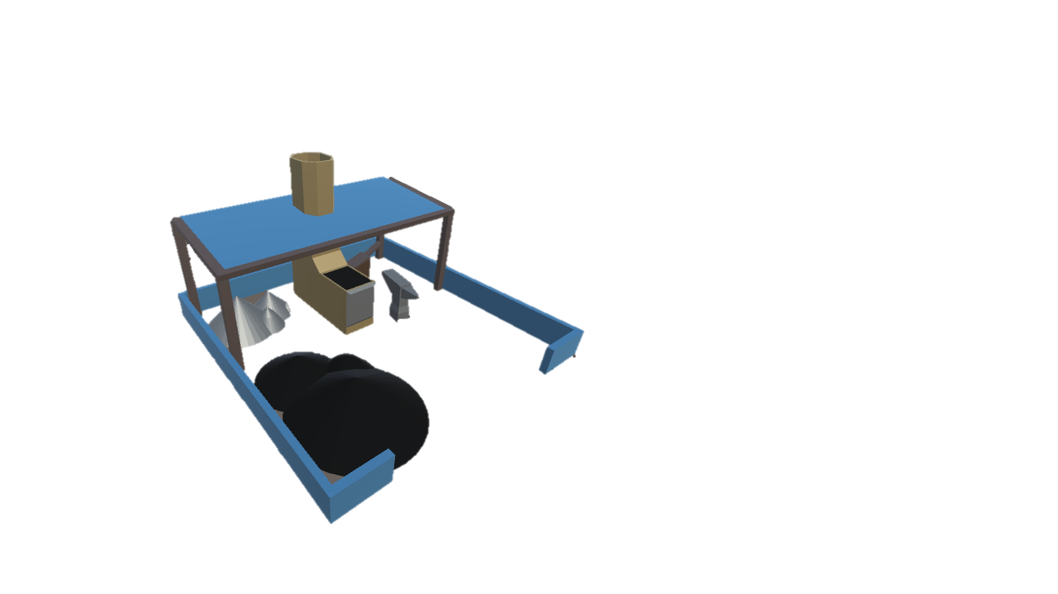
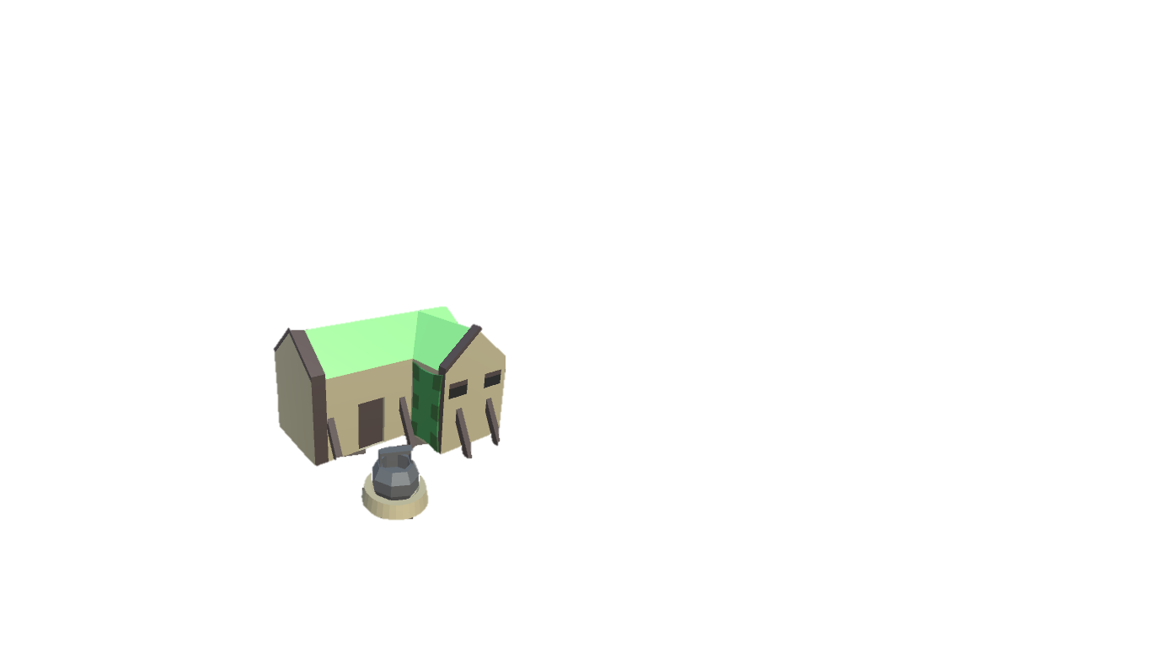
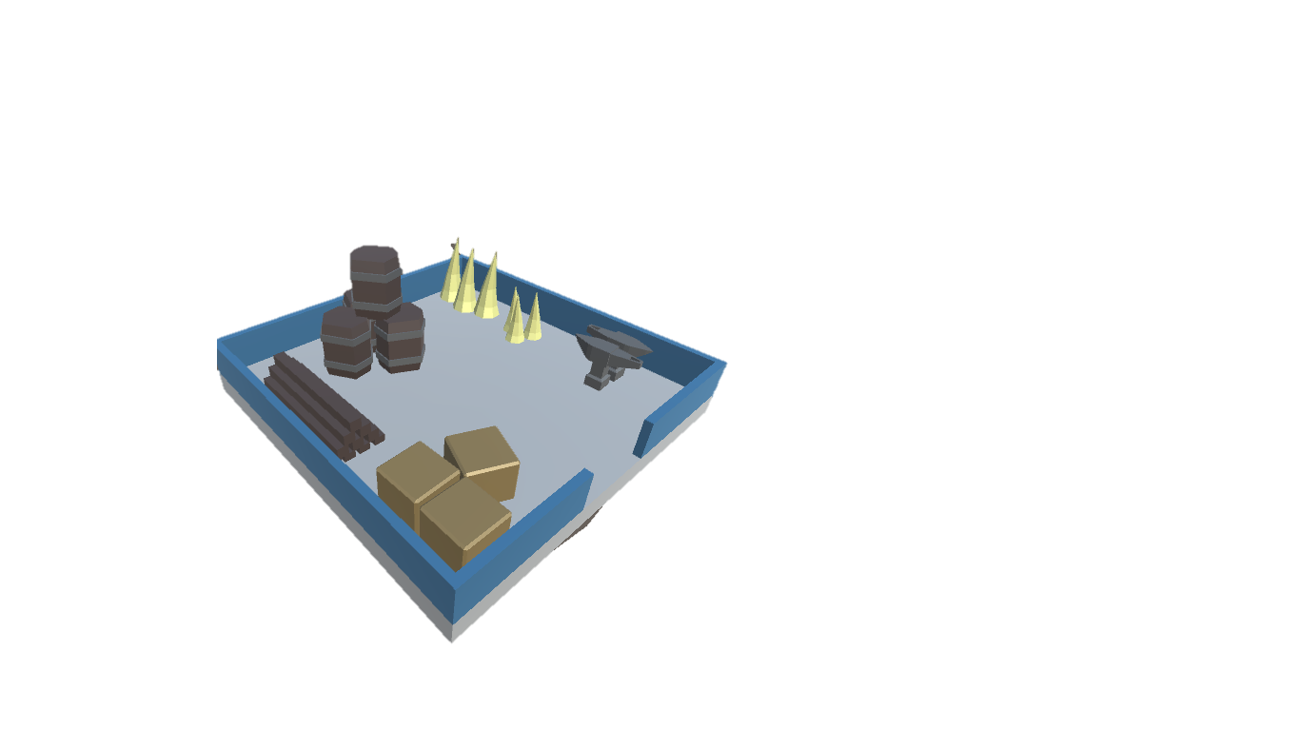
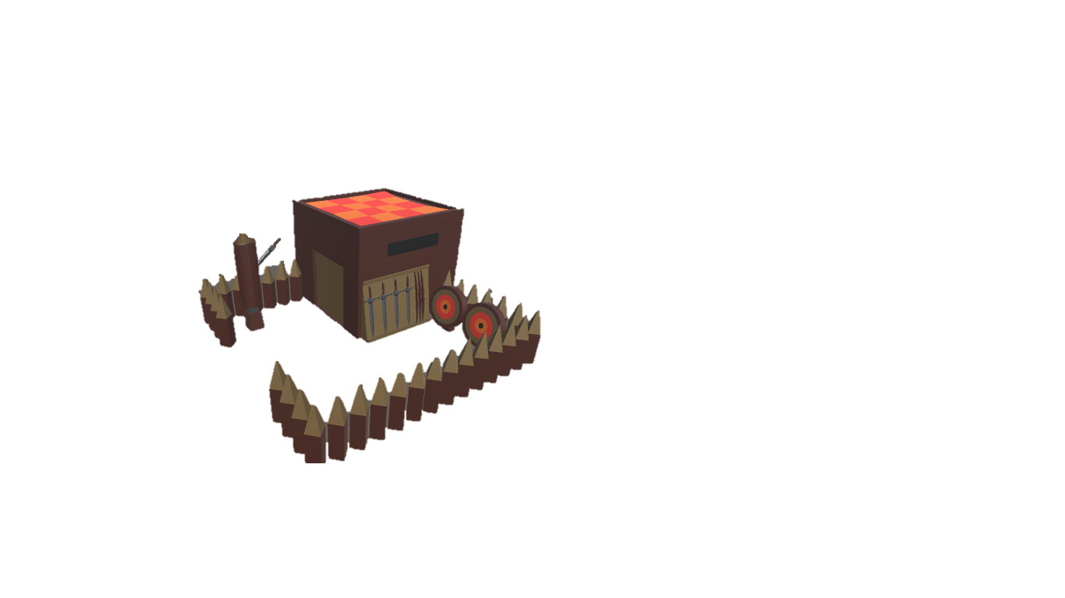
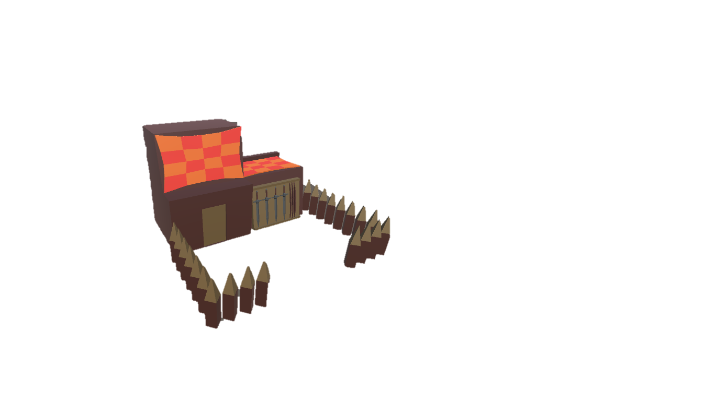
Art Assets (Buildings)
DS

Slide 14
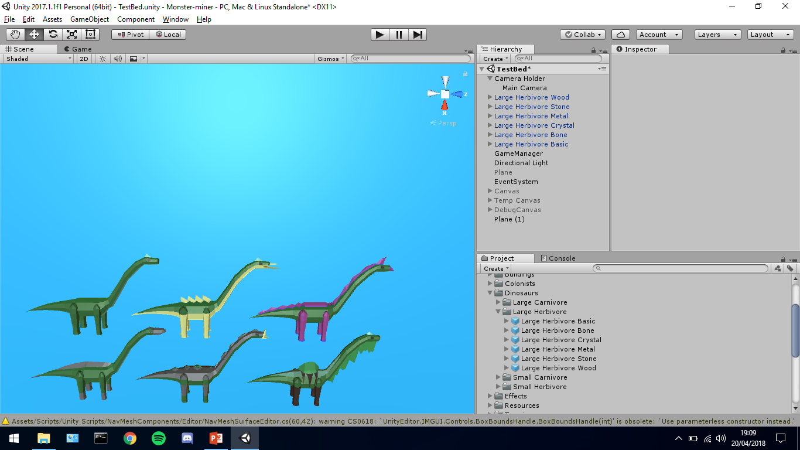
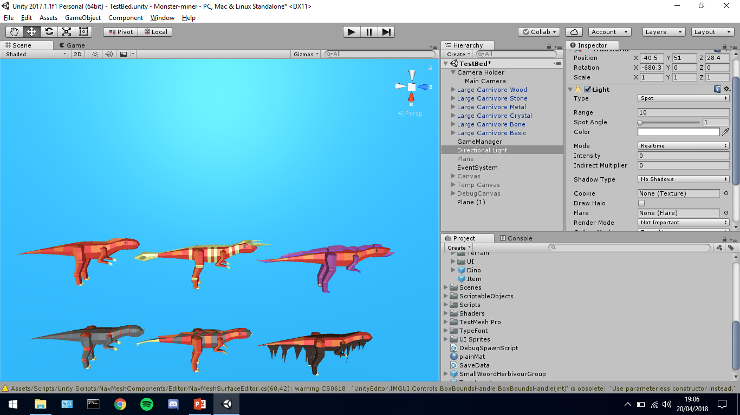
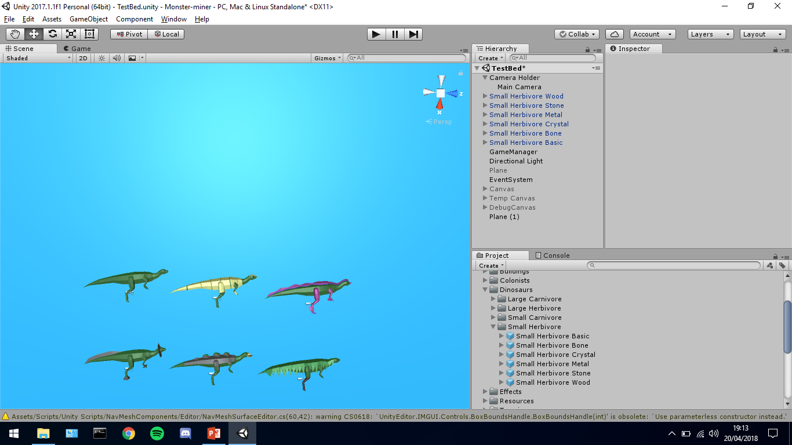
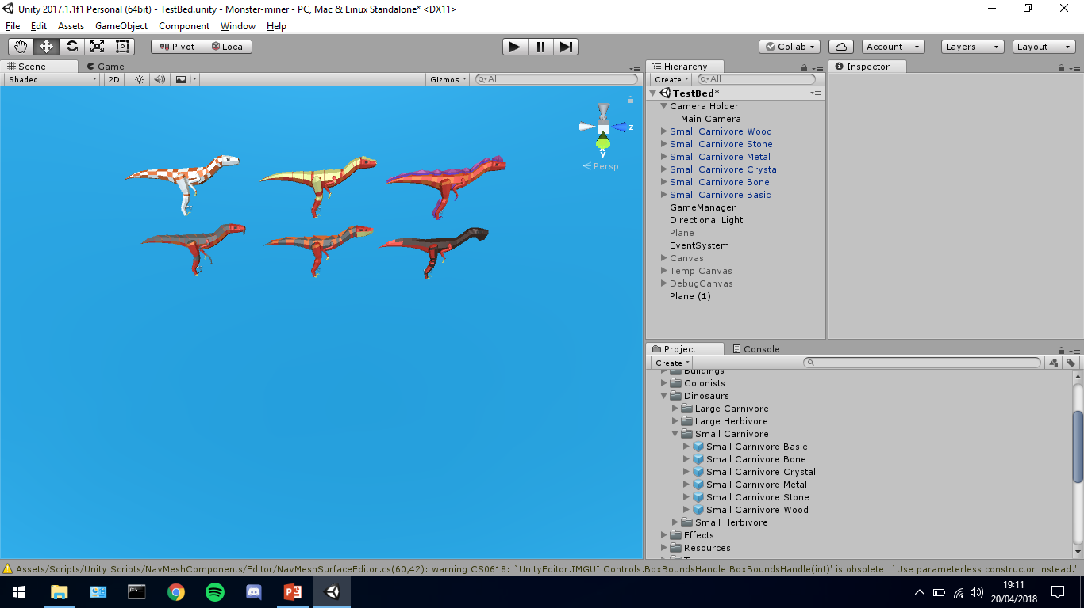
Art Assets (Monsters)
DS

Slide 15
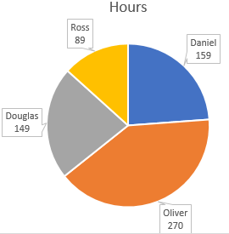
Management
Daniel: 3w 4d 6h 30m
Douglas: 3w 3d 5h 3m
Oliver: 6w 3d 6h 25m
Ross: 2w 1d 0h 35m
RW

Slide 16
Questions?

